Slide 1
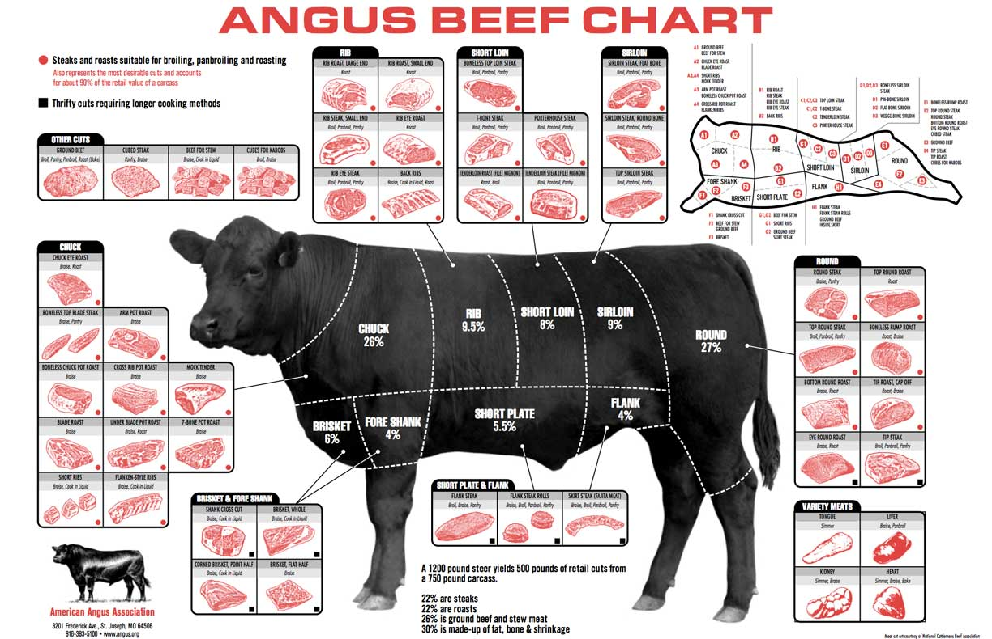
The Ethics of Eating Meat

Slide 2
Eating meat: moral issues
Some people argue that eating meat is wrong simply because it involves killing an animal.
Others argue that eating meat is wrong because it promotes farming practices that damage the environment.
Others argue that eating meat is wrong because it wastes food resources that could be used to feed the malnourished people of the world.

Slide 3
Eating meat: moral issues
Today we consider a different argument.
This argument targets a specific form of meat: meat derived from factory-farmed animals.
The argument is that eating factory-farmed meat is wrong, because it causes a large amount of suffering for the sake of a relatively small amount of enjoyment.

Slide 4
Factory Farming
Factory farming is a method of raising livestock for food, milk, and eggs that involves maintain-ing high-density populations of animals in scientifically controlled environments.
It is an agricultural form of mass production.

Slide 5
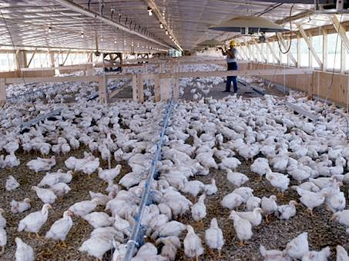
Factory Farming
A chicken house. These chickens are being raised for food.

Slide 6
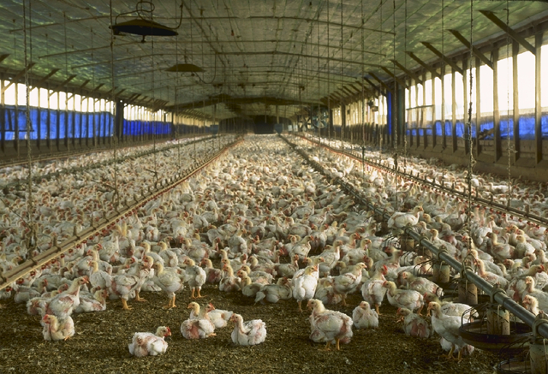
Factory Farming
Another chicken house.

Slide 7
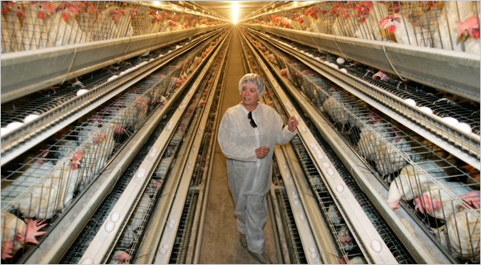
Factory Farming
An industrial-scale egg farm.

Slide 8
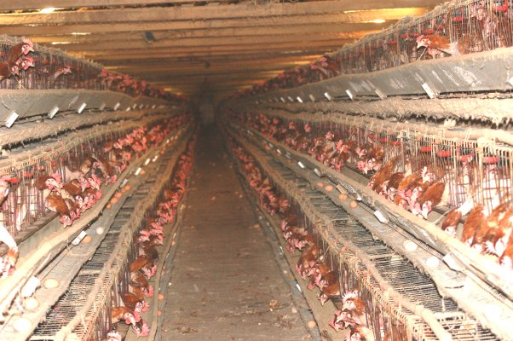
Factory Farming
Another egg farm.

Slide 9
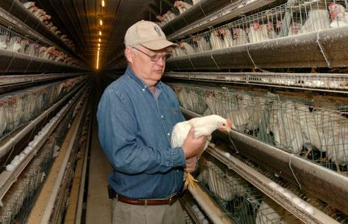
Factory Farming
And another.

Slide 10
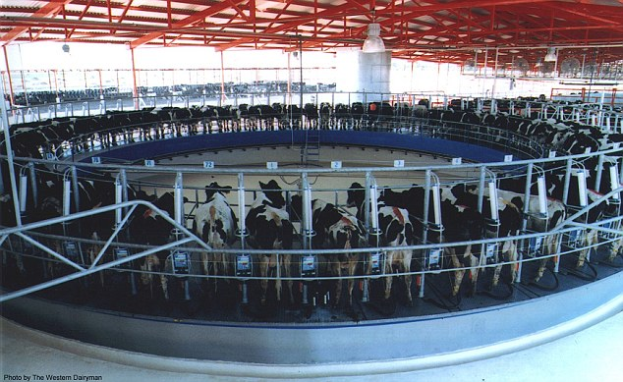
Factory Farming
An industrial-scale dairy farm.

Slide 11
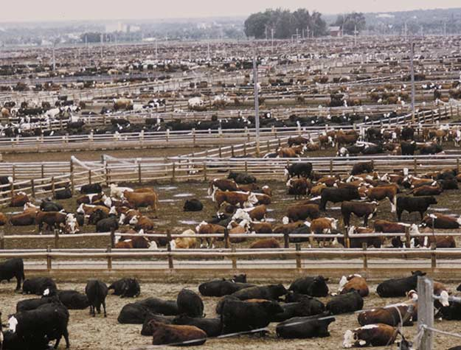
Factory Farming
Beef cattle on a feedlot.

Slide 12
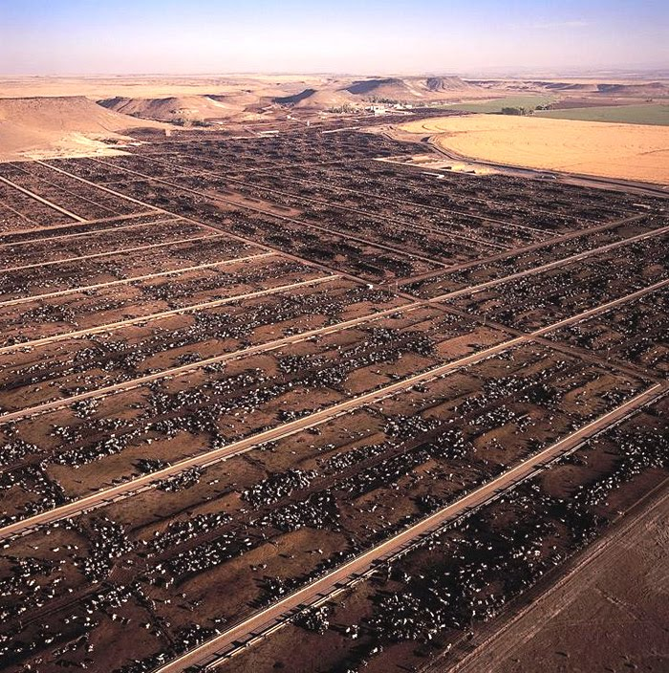
Factory Farming
Aerial view of a large cattle feedlot.

Slide 13
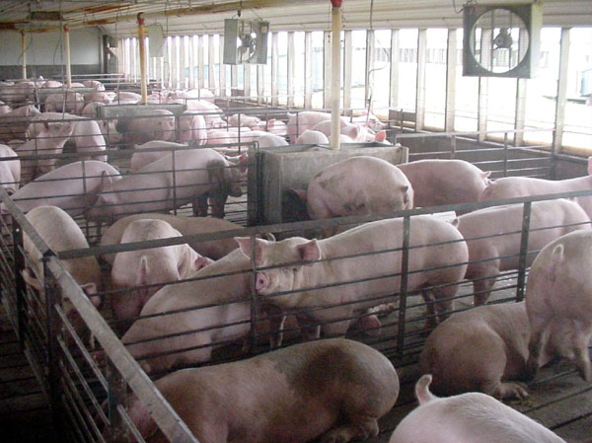
Factory Farming
Factory farmed pigs.

Slide 14
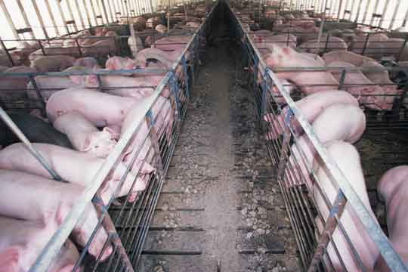
Factory Farming
More factory farmed pigs.

Slide 15
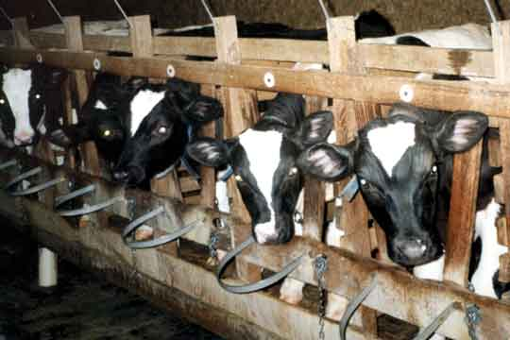
Factory Farming
Veal calves.

Slide 16
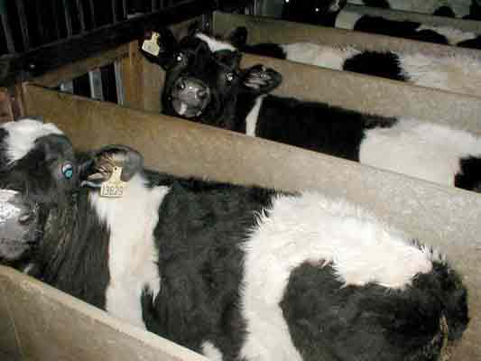
Factory Farming
More veal calves.

Slide 17
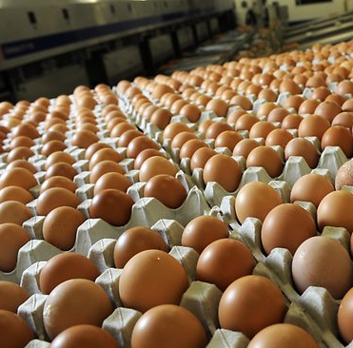
What can I do?
It takes more than 6,000,000 factory-farmed hens to supply Singapore with eggs, at present levels of consumption.
That’s more than one hen per Singapore resident.

Slide 18
What can I do?
However, the local chicken industry isn’t going to notice if I quit eating eggs.
So, my quitting wouldn’t cause the industry to raise fewer hens.
So I may as well continue to enjoy eggs.

Slide 19
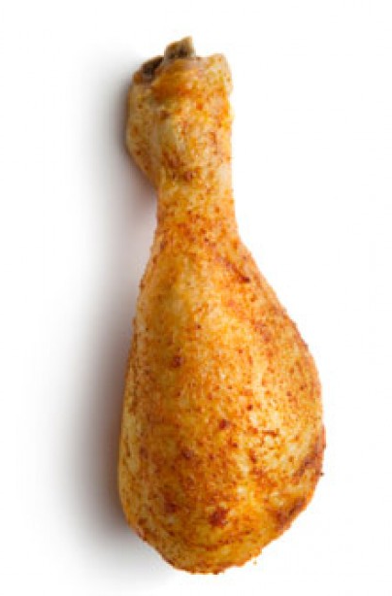
What can I do?
However, the local chicken industry isn’t going to notice if I quit eating eggs.
So, my quitting wouldn’t cause the industry to raise fewer hens.
So I may as well continue to enjoy eggs.
Notes:
Notice that the same reasoning, if sound, also applies to veal, etc.

Slide 20
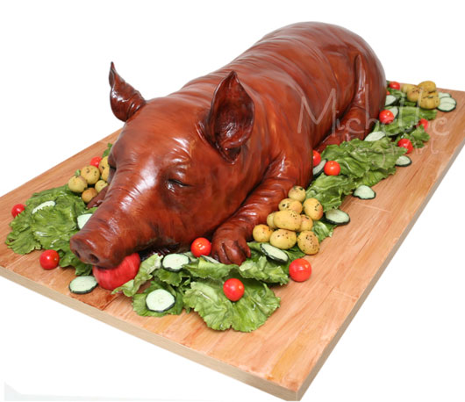
What can I do?
However, the local chicken industry isn’t going to notice if I quit eating eggs.
So, my quitting wouldn’t cause the industry to raise fewer hens.
So I may as well continue to enjoy eggs.
Notes:
Notice that the same reasoning, if sound, also applies to veal, etc.

Slide 21
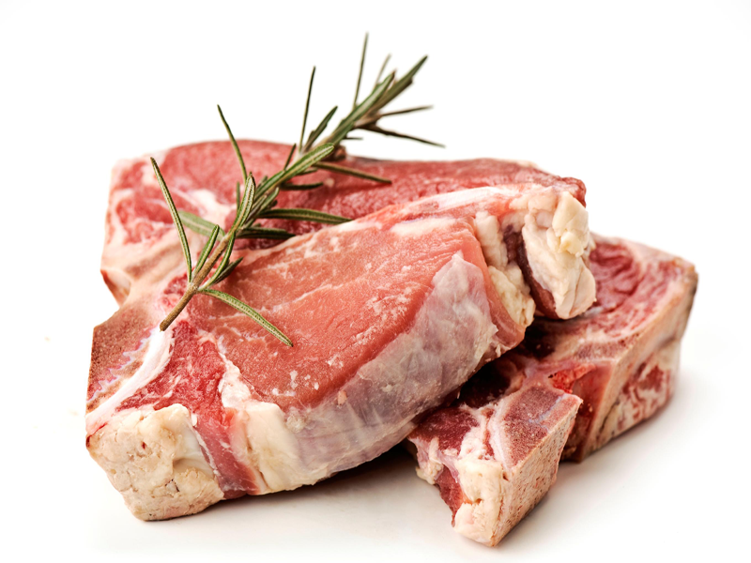
What can I do?
However, the local chicken industry isn’t going to notice if I quit eating eggs.
So, my quitting wouldn’t cause the industry to raise fewer hens.
So I may as well continue to enjoy eggs.
Notes:
Notice that the same reasoning, if sound, also applies to veal, etc.

Slide 22
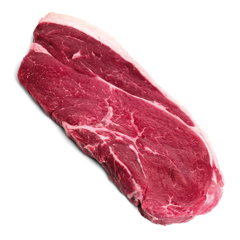
What can I do?
However, the local chicken industry isn’t going to notice if I quit eating eggs.
So, my quitting wouldn’t cause the industry to raise fewer hens.
So I may as well continue to enjoy eggs.
Notes:
Notice that the same reasoning, if sound, also applies to veal, etc.

Slide 23
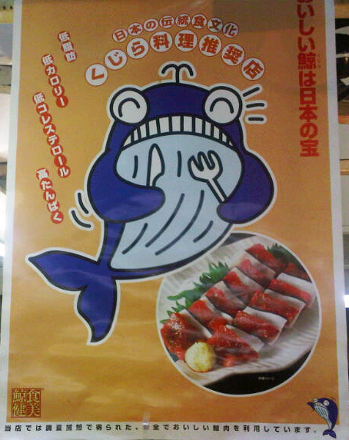
What can I do?
However, the local chicken industry isn’t going to notice if I quit eating eggs.
So, my quitting wouldn’t cause the industry to raise fewer hens.
So I may as well continue to enjoy eggs.
Notes:
Notice that the same reasoning, if sound, also applies to veal, etc.

Slide 24
Reply
Your choice can make a difference without determining the outcome.
After all, if nobody’s choice made a difference, the egg farms would continue to operate even if everyone quit eating eggs!

Slide 25


The Puppy Argument
You would refuse to eat dessert at Fred’s house, even if you knew that it wouldn’t discourage him from torturing puppies.
Factory-farmed animals are treated as badly as Fred’s puppies.
Therefore, you should refuse to eat factory-farmed products, even though you know that it will not discourage people from raising animals on factory farms.

Slide 26
The Puppy Argument
You would refuse to eat dessert at Fred’s house, even if you knew that it wouldn’t discourage him from torturing puppies.
Factory-farmed animals are treated as badly as Fred’s puppies.
Therefore, you should refuse to eat factory-farmed products, even though you know that it will not discourage people from raising animals on factory farms.

Slide 27
The Puppy Argument
You would refuse to eat dessert at Fred’s house, even if you knew that it wouldn’t discourage him from torturing puppies.
Factory-farmed animals are treated as badly as Fred’s puppies.
Therefore, you should refuse to eat factory-farmed products, even though you know that it will not discourage people from raising animals on factory farms.

Slide 28
The Puppy Argument
You would refuse to eat dessert at Fred’s house, even if you knew that it wouldn’t discourage him from torturing puppies.
Factory-farmed animals are treated as badly as Fred’s puppies.
Therefore, you should refuse to eat factory-farmed products, even though you know that it will not discourage people from raising animals on factory farms.

Slide 30
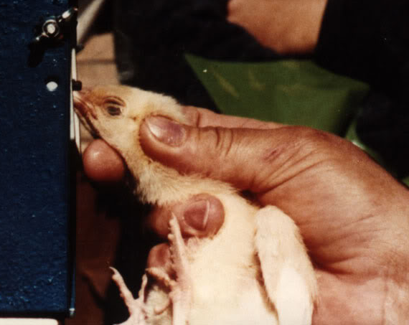
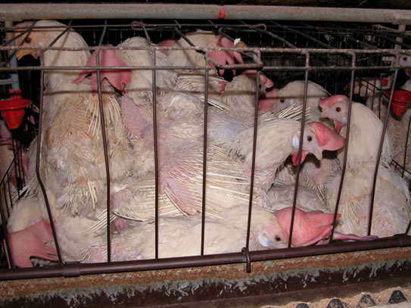
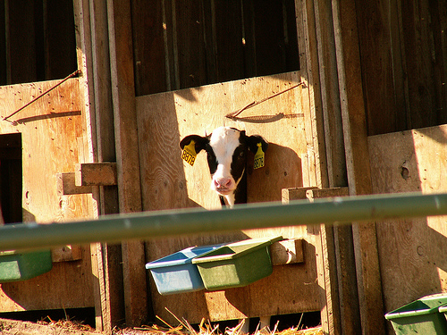

Slide 31
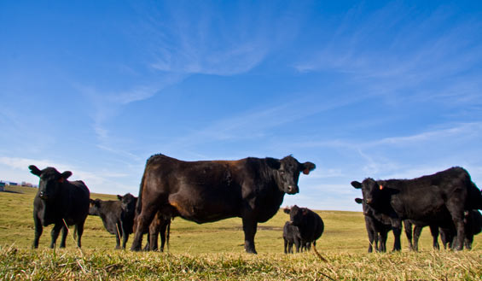
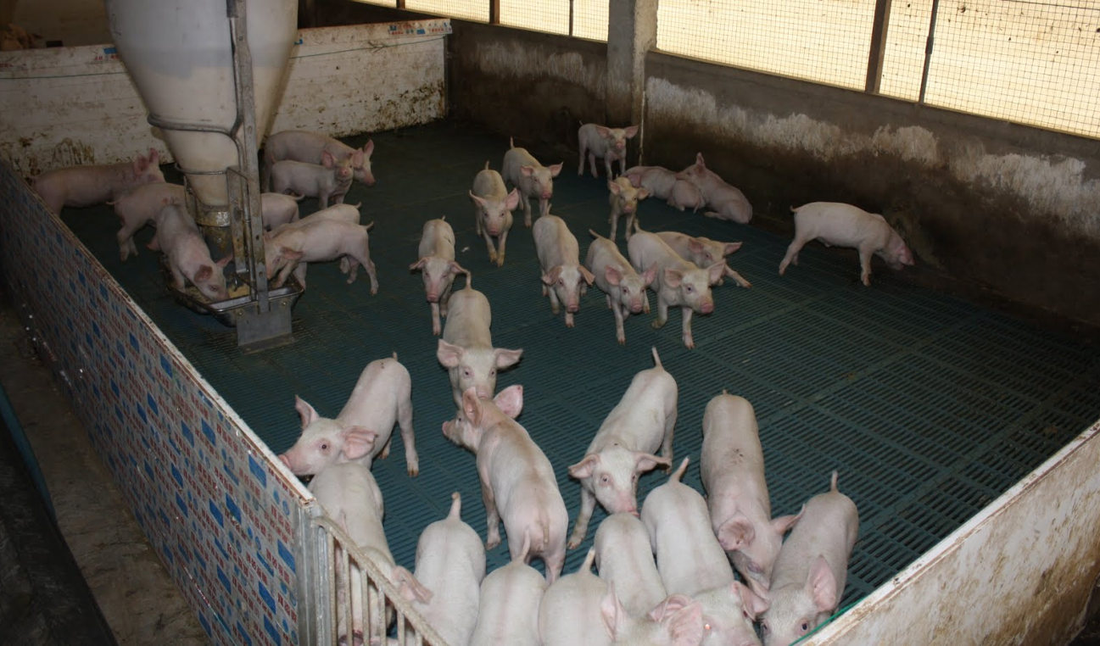
Notes:
So maybe the lives of some factory farmed animals aren’t so bad.

Slide 33
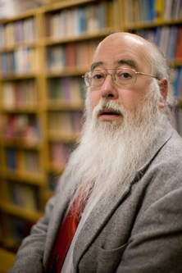
Loren Lomasky,
Meat Lover

Slide 34
For non-human animals, pleasure is all that matters.
So, as long as the animals living on factory farms have more pleasure than pain in their lives, their lives are worth living.
And, apart from veal calves and egg-layers, it seems reasonable to suppose that factory-farmed animals do have more pleasure than pain in their lives.
Loren Lomasky,
Meat Lover

Slide 35
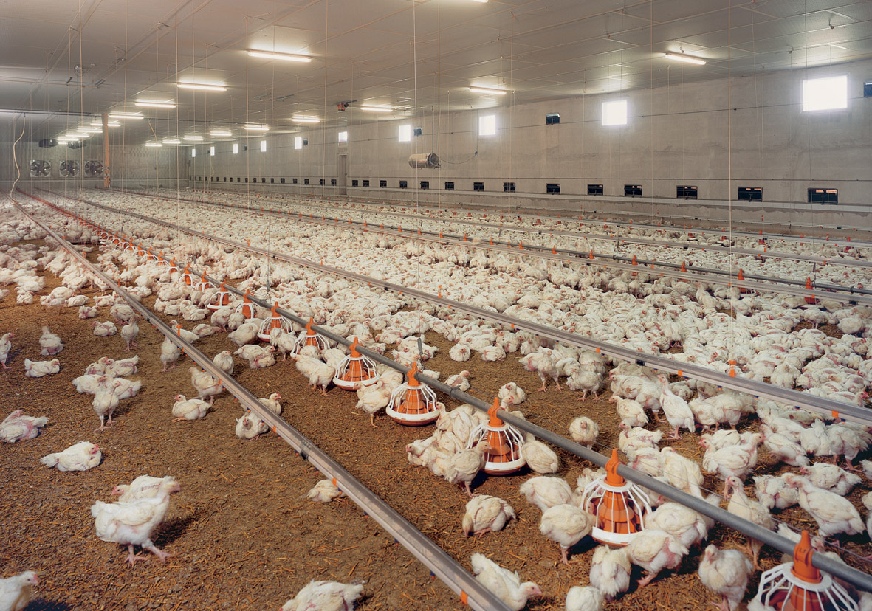
Factory Farmed Chickens

Slide 36
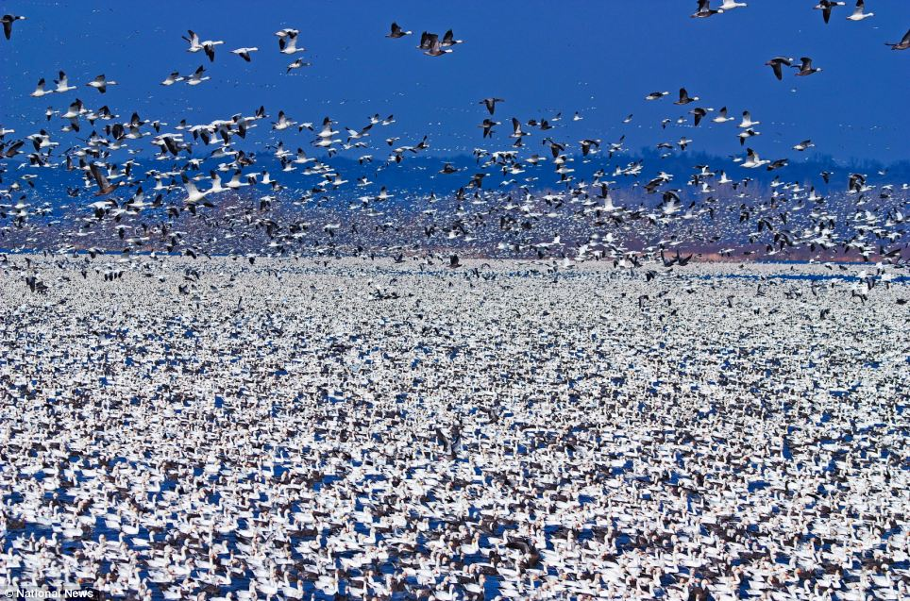
Wild Geese

Slide 37
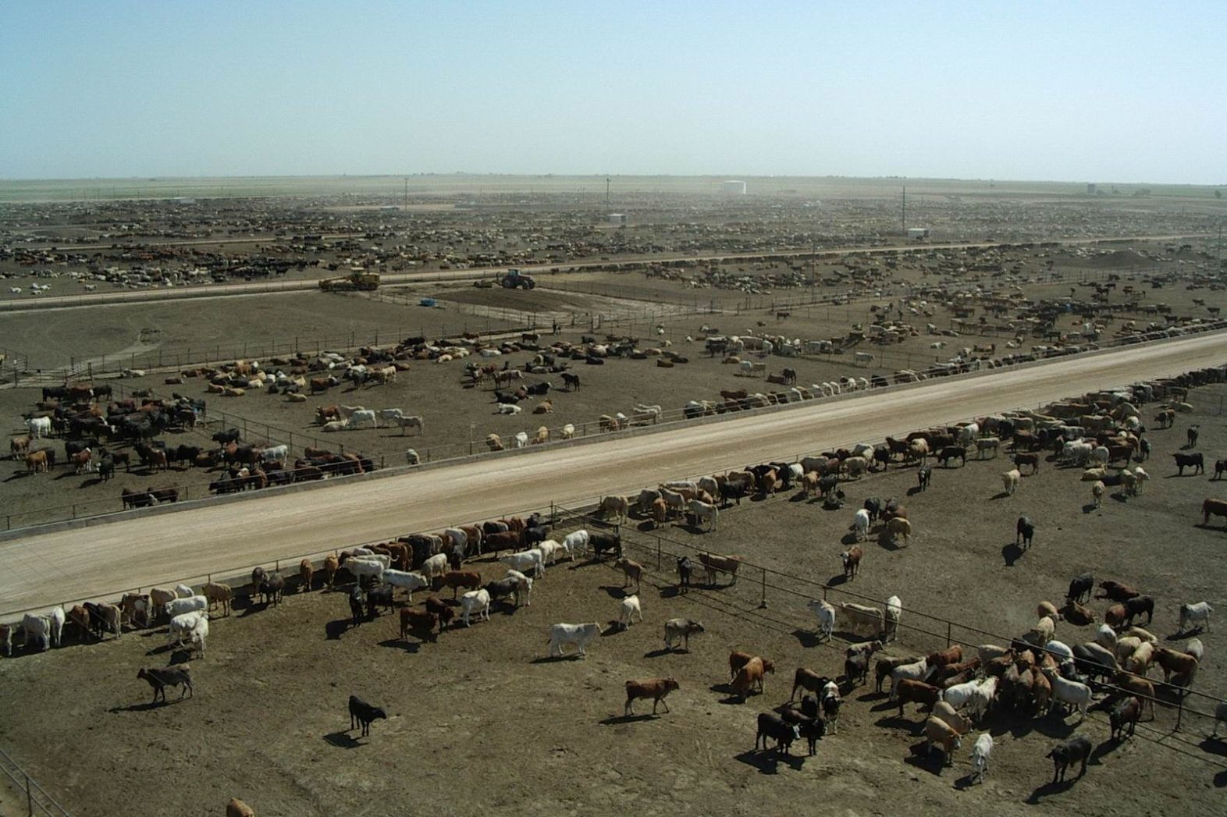
Factory Farmed Bovines

Slide 38
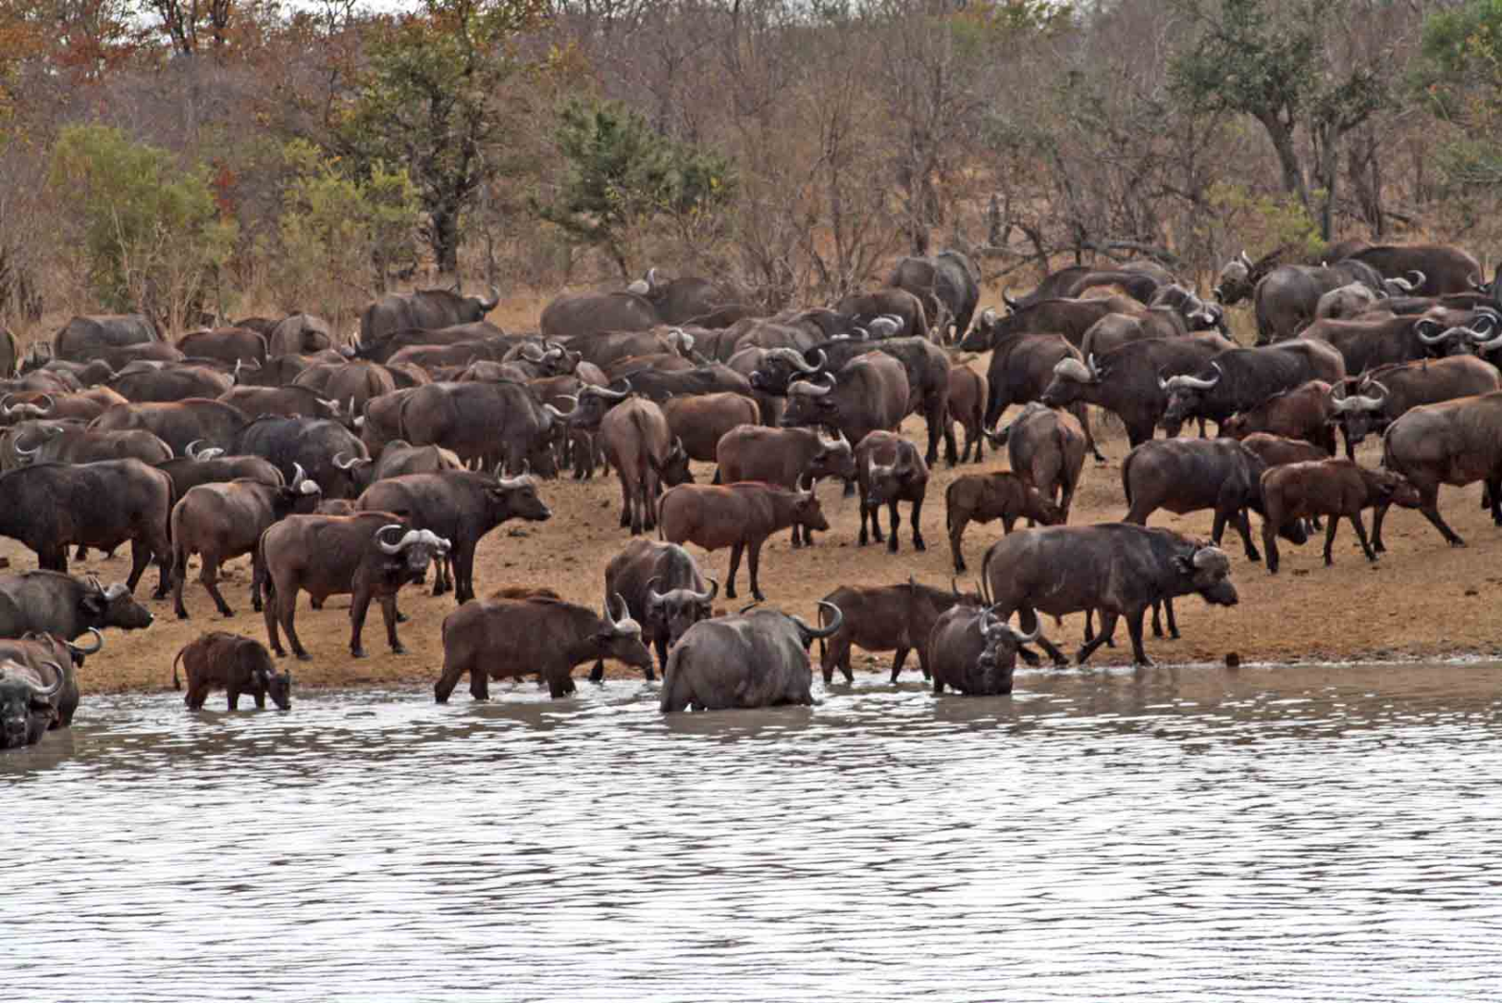
Wild Bovines

Slide 39
Loren Lomasky,
Meat Lover

Slide 40
I conclude that there is nothing unethical with consuming factory-farmed products (apart from eggs and veal).
Loren Lomasky,
Meat Lover

Slide 41
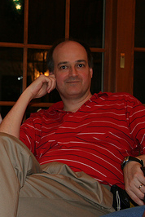
Alastair Norcross,
Factory Farming Opponent

Slide 42
Suppose that some factory-farmed animals do have lives worth living.
How does that justify your support of factory farming?
Your argument seems to be: “Since the animals have lives that are worth living, it’s OK for us to kill them”!
Alastair Norcross,
Factory Farming Opponent

Slide 43
Suppose that some factory-farmed animals do have lives worth living.
How does that justify your support of factory farming?
Your argument seems to be: “Since the animals have lives that are worth living, it’s OK for us to kill and eat them”!
Alastair Norcross,
Factory Farming Opponent

Slide 44
Loren Lomasky,
Meat Lover

Slide 45
My point is that these animals wouldn’t be alive at all, if it weren’t for the fact that we planned to eat them.
So, as long as the animals that live on factory farms do have lives worth living, I do nothing wrong by supporting factory farming with my meat-buying dollars.
Loren Lomasky,
Meat Lover
Notes:
It’s not a choice between the animals living on FFs and the animals frolicking freely. It’s a choice between the animals living on FFs and not living at all.

Slide 46
My point is that these animals wouldn’t be alive at all, if it weren’t for the fact that we planned to eat them.
So, as long as the animals that live on factory farms have lives worth living, I do nothing wrong by supporting factory farming with my meat-buying dollars.
Loren Lomasky,
Meat Lover

Slide 47
Alastair Norcross,
Factory Farming Opponent

Slide 48
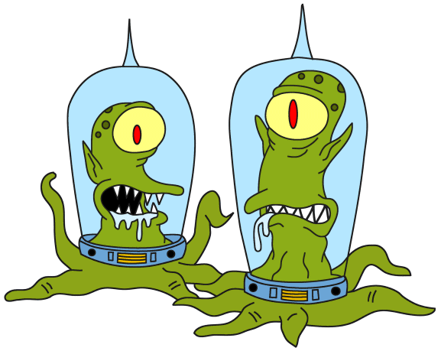
Alastair Norcross,
Factory Farming Opponent

Slide 49
By your logic, Lomasky, the aliens are not doing anything that is morally wrong!
Alastair Norcross,
Factory Farming Opponent

Slide 50
Not so fast.
I said that hedonism is a correct theory of value for non-human lives.
But unlike cows and chickens, human beings have rights.
They have a right not to be used as livestock, and if they are being used as livestock, they have a right to know it.
Loren Lomasky,
Meat Lover

Slide 51
Not so fast.
I said that hedonism was a correct theory of value for the lives of farm animals.
But the value of a human life depends on more than pleasure and absence of pain.
It also depends on personal liberty and freedom from ignorance.
Loren Lomasky,
Meat Lover

Slide 52
Alastair Norcross,
Factory Farming Opponent

Slide 53

Alastair Norcross,
Factory Farming Opponent

Slide 54
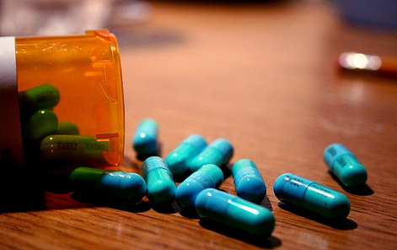
Alastair Norcross,
Factory Farming Opponent

Slide 55
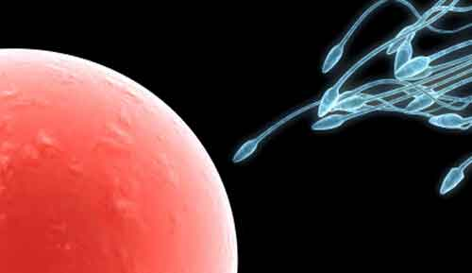
Alastair Norcross,
Factory Farming Opponent

Slide 57
Did these parents do something morally wrong?
Their child has a happy life---a life that seems to be worth living.
The child would not have existed at all if the parents hadn’t taken the pills.
So, by Lomasky’s logic, they have done nothing wrong.

Slide 58
Did these parents do something morally wrong?
Their child has a happy life---a life that seems to be worth living.
The child would not have existed at all if the parents hadn’t taken the pills.
So, by Lomasky’s logic, they have done nothing wrong.

Slide 59
Did these parents do something morally wrong?
Their child has a happy life---a life that seems to be worth living.
The child would not have existed at all if the parents hadn’t taken the pills.
So, by Lomasky’s logic, they have done nothing wrong.

Slide 60
Did these parents do something morally wrong?
Their child has a happy life---a life that seems to be worth living.
The child would not have existed at all if the parents hadn’t taken the pills.
So, by Lomasky’s logic, they have done nothing wrong.

Slide 62
conclusions

Slide 64
The main argument against factory farming is that it causes a large amount of animal suffering for the sake of a relatively paltry amount of human enjoyment.
But it is not obvious that all factory farmed animals have more pain than pleasure over the course of their (brief) lives.
You can consume products derived from those animals with a clear conscience, unless you think that the parents in the pills example did something morally wrong.

Slide 65
The main argument against factory farming is that it causes a large amount of animal suffering for the sake of a relatively paltry amount of human enjoyment.
But it is not obvious that all factory farmed animals have more pain than pleasure over the course of their (brief) lives.
You can consume products derived from those animals with a clear conscience, unless you think that the parents in the pills example did something morally wrong.

Slide 66
The main argument against factory farming is that it causes a large amount of animal suffering for the sake of a relatively paltry amount of human enjoyment.
But it is not obvious that all factory farmed animals have more pain than pleasure over the course of their (brief) lives.
You can consume products derived from those animals with a clear conscience, unless you think that the parents in the pills example did something morally wrong.

Slide 67
End of lecture.

Slide 68
Weekly Assignment #4
Summarize Smart’s discussion of the problem of evil.
Word limit: 200 max.
Upload by: 8pm Thursday 18 September.

